Slide 1
Seliwanoff’s Test

Slide 2
The Seliwanoff colour reaction for fructose is due to the Russian chemist Feodor Feodorovich Selivanov
The test, 0.1% resorcinol in 4M HCl, has been extended to ketohexoses which also give the deep cherry-red colour.

Slide 3
This indicates that ketoses are dehydrated more rapidly than aldoses to give a furan derivative that finally reacts with the reagent producing the observed colouration
why ketoses react faster than aldoses in the same reaction conditions
Since glucose reacts much slower than fructose as observed in the Seliwanoff’s Test, we thought that this delay could be attributed to a previous isomerization of glucose to fructose

Slide 6
Fructose is an important and interesting ketose. It is well-tolerated by diabetics . Unlike glucose, fructose does not stimulate a substantial insulin release.
Fructosuria is a rare disorder from liver malfunction. Fructose in urine can be detected by the Seliwanoff’s Test
This test showed that fructose reacts faster than glucose in order to give a positive result: patent with fructose and slightly pink with glucose.

Slide 7
The reaction consists in the triple dehydration of the monosaccharide to 5-hydroxymethylfurfural (ketohexoses) or to furfural (ketopentoses). Finally, the furan derivative reacts with resorcinol to give the coloured condensation product.

Slide 8
On dehydration both ketohexoes and aldohexoes give hydroxymethyl furfural but the relative amount of this product is vary according weather one works with aldoses or ketoses.
Aldohexoes yeilding only small amount of the hydroxymethyl furfural which resposible for no significant change in the color or appearance of only light pink to yellow color which develop in longer time.

Slide 9
Several structures have been proposed for the red compound.

Slide 12
Take two clean, dry test tubes and add 1 ml of the test sample in one test tube.
Add 2 ml of Seliwanoffs’ reagent to both the test tubes.
Keep both the test tubes in a water bath for 1-2 min.
Observe the formation of color and note it down.

Slide 13
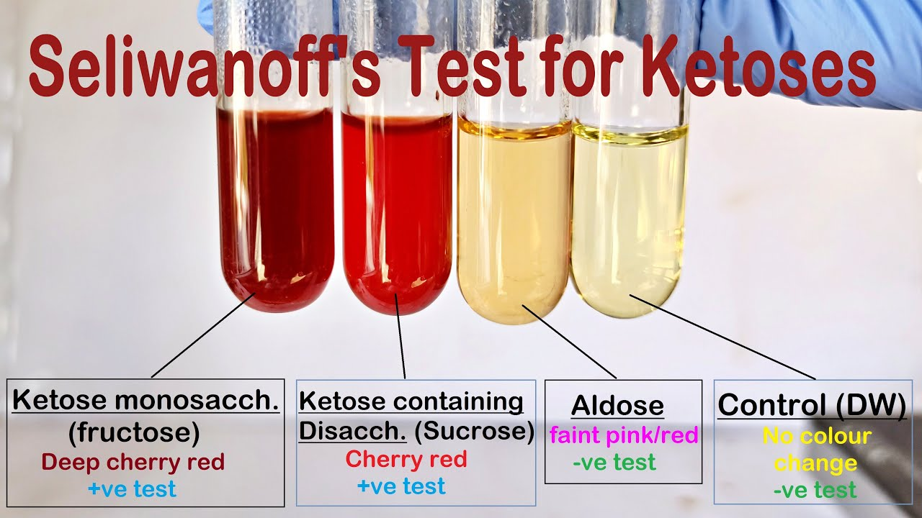
This test is a generalized test and doesn’t distinguish between specific ketoses, and a separate test is required for the particular ketose sugar identification.

Slide 14
Bial’s test (Orcinol)
Bial’s test is a chemical test performed to detect the presence of pentoses
Objective
To distinguish between the pentoses and hexoses.
Reagent
Bial's reagent consist of a solution of orcinol, HCl and ferric chloride)

Slide 15
pentoses are dehydrated by concentrated acid to yield furfural, which in turn condense with orcinol to form a blue-green precipitate.
In the presence of hexoses, hydroxyfurfural is formed instead of furfural which upon condensation with orcinol forms a muddy brown colored precipitate.
The intensity of the precipitation is directly proportional to the concentration of the pentoses in the sample.

Slide 16
bial’s test is a sensitive and specific test for pentoses sugars(ribose, ribulose, xylose, and arabinose)and other biochemical molecules containing these pentoses(what are they?)
Pentoses give blue-green color complex within short time, some hexoses in prolonged heating yield hydroxymethylfurfural which react with orcinol to give muddy brown color complex.

Slide 17
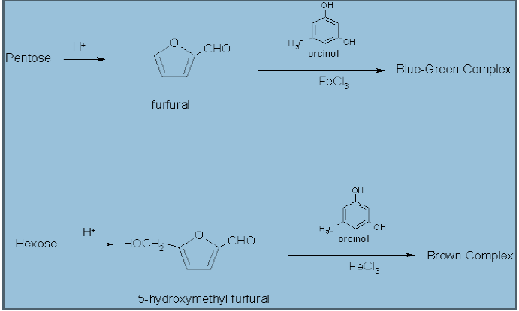

Slide 18
) to 2 ml of Bial’s reagent add (5drops) of test solution(ribose or fructose) and warm gently in a hot water bath for 1-2 minutes.
2) a bluish – green color indicates a positive result (pentoses). Prolonged heating form muddy brown products indicates (hexoses).
NOTE:-
The dehydration agent is HCL.
The condensation agent is orcinol and ferric chloride.

Slide 19
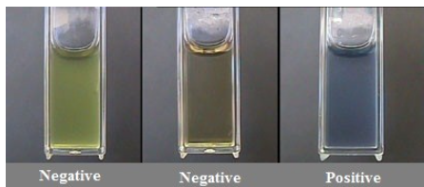
Positive Bial’s test: formation of blue color ( eg. Ribose sugar)
Negative Bial’s test: formation of any other color indicates negative test. Hexose sugar ( glucose, fructose) generally gives green, red or brown color product.

Slide 20
This test is used to detect the presence of pentose in a given sample
This test can additionally be used for the quantification of RNA in a sample

